Slide 1
CSE302-Software Quality Engineering Software Testing
Instructor: Sobia Usman
Assistant Professor
CS - CUI, LHR

Slide 2
Testing Strategies
There are basically two testing strategies:
Big bang testing: tests the software as a whole, once the completed package is available
Incremental testing:
Tests the software piecemeal – software modules are tested as they are completed (unit tests)
followed by groups of modules composed of tested modules integrated with newly completed modules (integration tests).
Once the entire package is completed, it is tested as a whole (system test).

Slide 3
Testing Strategies
Incremental testing is also performed according to two basic
strategies:
bottom-up and top-down
In top-down testing, the first module tested is the main module, the highest level module in the software structure; the last modules to be tested are the lowest level modules.
In bottom-up testing, the order of testing is reversed: the lowest level modules are tested first, with the main module tested last.

Slide 4
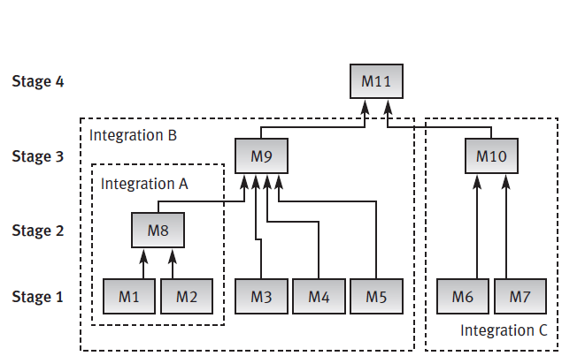
Bottom-up Testing
Stage 1: Unit tests of modules 1 to 7.
Stage 2: Integration test A of modules 1
and 2, developed and tested in stage 1, and integrated with module 8, developed in the current stage.
Stage 3: Two separate integration tests, B, on modules 3, 4, 5 and 8, integrated with module 9, and C, for modules 6 and 7, integrated with module 10.
Stage 4: System test is performed after B and C have been integrated with module 11, developed in the current stage

Slide 5
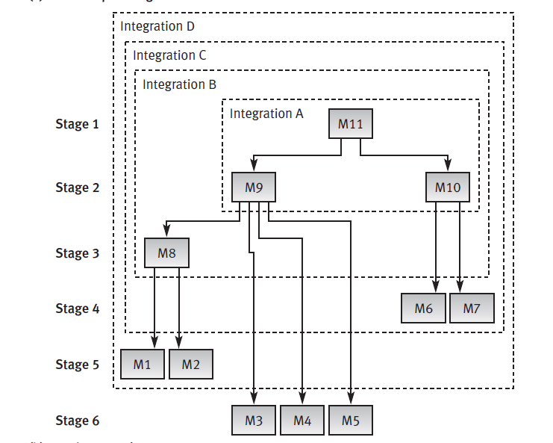
Top-down Testing
Stage 1: Unit tests of module 11.
Stage 2: Integration test A of module 11 integrated with modules 9 and 10, developed in the current stage.
Stage 3: Integration test B of A integrated with module 8, developed in the current stage.
Stage 4: Integration test C of B integrated with modules 6 and 7, developed in the current stage.
Stage 5: Integration test D of C integrated with modules 1 and 2, developed in the current stage.
Stage 6: System test of D integrated with modules 3, 4 and 5, developed in the current stage.

Slide 6
Stubs and Drivers for Incremental Testing
Stubs and drivers are software replacement simulators required for modules not available when performing a unit or an integration test.
A stub (often termed a “dummy module”) replaces an unavailable lower level module.
Stubs are used in top down testing approach
when you have the major module ready to test, but the sub modules are still not ready yet.
So in a simple language stubs are "called" programs, which are called in to test the major module's functionality.

Slide 7
Stubs and Drivers for Incremental Testing
A driver is also a substitute module but of the upper level module
Drivers are required in bottom-up testing until the upper level modules are developed (coded).
They are used when the sub modules are ready but the main module is still not ready.
Drivers are the ones, which are the "calling" programs

Slide 8
Example of Stubs and Drivers
For Example
we have 3 modules login, home, and user module. Login module is ready and need to test it, but we call functions from home and user (which is not ready). To test at a selective module we write a short dummy piece of a code which simulates home and user, which will return values for Login, this piece of dummy code is called Stubs and it is used in a top down integration.

Slide 9
Example of Stubs and Drivers
Considering the same Example above:
If we have Home and User modules get ready and Login module is not ready, and we need to test Home and User modules which return values from Login module. So to extract the values from Login module, we write a short piece of dummy code for login which returns value for home and user. So these pieces of code is always called Drivers and it is used in Bottom Up Integration.

Slide 10
Software Test Classification
Software tests may be classified according to the testing concept or to the requirements classification(McCalls Quality Factor)
Black box (functionality) testing.
Testing that ignores the internal mechanism of a system or component and focuses solely on the outputs generated in response to selected inputs and execution conditions.
Testing conducted to evaluate the compliance of a system or component with specified functional requirements.
White box (structural) testing
Testing that takes into account the internal mechanism of a system or component.

Slide 11
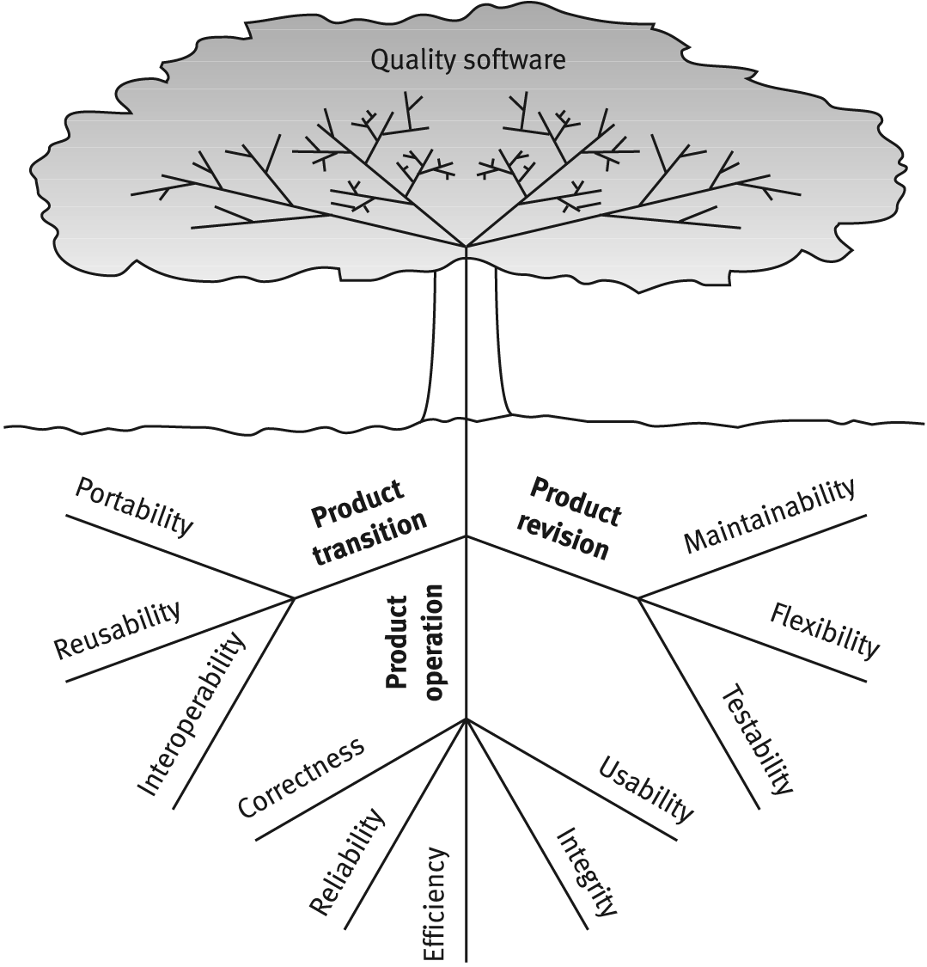
Classification according to Requirements
McCalls factor model tree

Slide 12
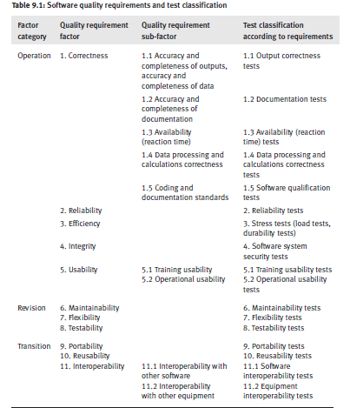

Slide 13
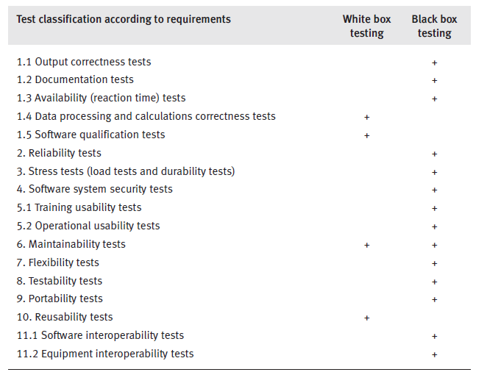
Software Testing

Slide 14
Testing Classes
Black box testing allows us to perform output correctness tests and most classes of tests as shown in table.
The black box tests are classified into three groups:
Operation factor testing classes
Revision factor testing classes
Transition factor testing classes.

Slide 15
Operation factor testing classes
(1) Output correctness tests
(2) Documentation tests (for correctness)
(3) Availability (reaction time) tests
(4) Reliability tests
(5) Stress tests (load tests, durability tests) (for efficiency)
(6) Software system security tests
(7) Training usability tests (for usability)
(8) Operational usability tests (for usability).

Slide 16
Revision /Transition factor Testing Classes
Revision factor testing classes include:
(1) Maintainability tests
(2) Flexibility tests
Transition factor testing classes include:
(1) Portability tests
(2) Reusability tests
(3) Software interfacing tests (for interoperability)
(4) Equipment interfacing tests

Slide 17
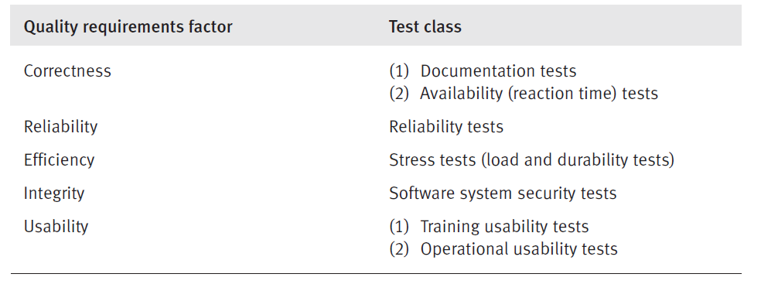
Black box testing

Slide 18
Correctness: Documentation Tests
Neglected in many cases
Common components of documentation, supplied by the developer are:
Functional descriptions of the software system
This overview enables the potential user to decide whether the system is suitable for his needs or not.
Installation manual
includes installation process
hardware requirements
instructions for interfacing with equipment

Slide 19
Correctness: Documentation tests
User manual
“How to get started” instructions
detailed instructions for applying the various system functions
Recovery instructions for common operator mistakes and system errors are all covered in the user manual.
Programmer manual.
This type of documentation is supplied for custom made software.
It includes the information required for maintaining the system (bug corrections, adaptation to changing requirements and software improvement), program structure, description of program logic including algorithms, and so on.

Slide 20
Correctness: Documentation tests
Document testing plans should include the following three components:
Document completeness check:
Based on the requirements specification and the detailed design reports
Its purpose is to check whether all the required documents have been completed as specified and as intended by the designer.
Document correctness tests.
Correctness tests determine whether the instructions listed in the user document are correct.
Document style
Refers to document clarity and its agreement with documentation standards

Slide 21
Correctness: Availability tests
Availability – reaction time (time needed to obtain the requested information or the time required for the firm ware installed in computerized equipment to react)
Difficult to test availability , especially for information systems planned to serve a large population of users
Carry out the tests under regular operation load as well as under maximal load conditions as specified in the requirement specifications
Availability requirements for regular and maximal workloads are usually different.

Slide 22
Reliability: Reliability tests
Average time between failures
Average time for recovery after system failure
Average downtime per month
Reliability tests also relate to the hardware , the operating system and the data communication system effects.
Such tasks should be carried out only after computerized simulations have been run to obtain average values, and only once the system is completed.

Slide 23
Efficiency: Stress tests
The class of stress tests include two main types of tests:
load tests
durability tests.
Stress tests: load tests
Load tests relate to the functional performance of the system under maximal operational load
Maximal transactions per minute
Hits per minute to an Internet site and the like.

Slide 24
Efficiency: Stress tests
Carried out by computerized tests based on simulations of high loads
These load simulations enable us to measure the expected reaction times
Allow us
To find out whether upgrading is necessary
which changes should be made to allow the software system to meet the planned requirements

Slide 25
Load Test: Example
“Music in the Air”, a network of music stores, run a service on the Internet that registers requests for price quotations and orders. On weekdays, the average rate of customer hits is 10 per minute for orders and 20 per minute for price quotations. The maximum loads recorded on Saturday afternoon are 30 per minute for orders and 100 per minute for price quotations.
The maximal load defined in the software specifications, which takes future growth into account, is 60 per minute for orders and 200 per minute for price quotation. The loads for which the program will be tested are 75 per minute for orders and 250 per minute for price quotations.

Slide 26
Stress Tests: Durability Tests
These tests are typically required for real-time firmware integrated into systems such as weapon systems, long-distance transport vehicles, and meteorological equipment.
Durability issues for firmware include
Firmware responses to climatic effects such as extreme hot and cold temperatures, dust, road bumps, and extreme operation failures resulting from sudden electrical failures
Information system software durability tests focus on operation failures resulting from sudden electrical failures, voltage “jumps” in the supply mains and so on.

Slide 27
Integrity :Software System Security Tests
Aimed at preventing unauthorized access to the system or parts of it.
Detection of unauthorized access
The activities performed by the penetration, and the recovery of damages caused by unauthorized penetration cases.
The main security issues dealt with by these tests are:
Access control, where the usual requirement is for control of multi-level access (usually by a password mechanism)
Backup of databases and software files and recovery in cases of system failure
Logging of transactions, system usage

Slide 28
Usability: Training Usability Tests
When large numbers of users are involved in operating a system, training usability requirements are added to the testing agenda.
The scope of training usability is defined by the resources needed to train a new employee.
In other words, how many hours of training are required for a new employee to achieve a defined level of acquaintance with the system.

Slide 29
Usability: Training Usability Tests
The details of these tests, like any other, are based on system characteristics but, more importantly here, on employee characteristics.
The results of the tests should inspire a sophisticated plan of training courses and follow-up as well as improved directions for software system operation.
Resources needed to train new employee
Training time (in hours)
System characteristics
Employee characteristics

Slide 30
Operational Usability Test
The focus of this class of tests is the operator’s productivity, that is, those aspects of the system that affect the performance regularly achieved by system operators, or that are applied mainly for information systems that serve many users.
These tests are of high importance in cases where the workings of the system can affect substantially the productivity of its users.
The implementation of this class of tests deals mainly with the productivity, quantitatively and qualitatively.

Slide 31
Operational Usability Test
Operational usability tests can be performed manually by means of time studies.
In addition to productivity data, these manual tests provide some insight into the reasons for (high or low) performance levels and initiate ideas for improvements.
Accurate performance records can be achieved by automated follow-up software that records all user activities throughout their shift.
Software packages of this type supply performance statistics and comparative figures for different variables, such as specific activity, time period, and industry.
Operator’s productivity
Performance achieved by operators
Reasons of (high or low) performance

Slide 32
Case Study
Bengal Tours is a city center travel agency that specializes in tours and vacations in Canada. The agency regularly employs 25 permanent employees. During the spring and summer, the agency employs an additional 20–25 temporary staff, mostly senior citizens and students. The agency is considering purchasing the right to use the software system “Tourplanex”, which supports the planning with flight and vacation site vacancies and price information. If purchased, the software will become the main working tool for the agency staff.

Slide 33
Solution:
Great attention should be given to the training usability achievements of “Tourplanex” because of the temporary staff the agency is employing
The tests should be of two phases. Phase one should deal with training usability. The agency should use temporary employees who will be trained by the software company.
The time spent in training should be listed and the performance of the trained employees should be measured in terms of minutes (seconds) required to reach the information needed for a typical inquiry.

Slide 34
Revision factor testing classes
Easy revision of software is a fundamental factor assuring
a software package’s successful
long service and its successful sales to larger user populations.
Maintainability tests
Flexibility tests
Testability tests.

Slide 35
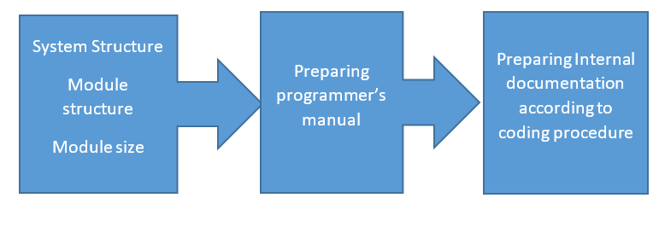
Maintainability :Maintainability tests
Maintainability tests relate mainly to these issues:
The system structure abides by the standards and development procedures imposed on the specific components for support of future maintenance activities, including the modular structure of self-contained modules and module size.
The programmer’s manual is prepared according to approved documentation standards and provides complete system documentation.
The internal documentation incorporated in the software code is prepared according to coding procedures and conventions and fully covers the system’s documentation requirements.

Slide 36
Flexibility : Flexibility tests
Software system flexibility refers to the system’s capabilities, based on its structural and programming characteristics.
These factors significantly affect the efforts required to adapt the software to the variety of customer needs as well as to introduce changes initiated by customers and maintenance teams for the purpose of improving system functionality.
Flexibility tests are intended to test the software characteristics that support flexibility, such as adequate modular structure and application of parametric options to provide a wide range of possible applications.

Slide 37
Example
TSS (teacher support software) deals with the documentation of pupil achievements, the calculation of final grades, the printing of term grade documents, and the automatic printing of warning letters to parents of failing pupils. The software specifications included the following flexibility requirements:
(a) The software should be suitable for teachers of all subjects and all school levels (elementary, junior and high schools).
(b) Non-professionals should be able to create new types of reports according to the schoolteacher’s requirements and/or the city’s education department demands.

Slide 38
Testability : Testability Tests
Testability requirements deal with the ease of testing the software system…
Testability relates to the addition of special features in the program that help the testers in their work, such as
The possibility of obtaining intermediate results for certain checkpoints and predefined log files.
These special testing support features should be specified in the requirements document as integral to the functional software requirements.

Slide 39
Testability : Testability tests
Testability deals with diagnostic tool applications
Some features of this kind are activated automatically when starting the software package or during regular operation and report whenever conditions warranting alarm arise.
Testability is particularly crucial for support of control rooms of large operating systems (e.g., electricity plants)
And for maintenance teams, especially with respect to diagnosis of failures.

Slide 40
Example
An industrial computerized control unit is programmed to calculate various measures of production status, report the performance level of the machinery, and operate a warning signal in predefined situations. One testability requirement demanded was to develop a set of standard test data with known system expected correct reactions in each stage. This standard test data is to be run every morning, before production begins, to check whether the computerized unit reacts properly.

Slide 41
Transition Factor Testing Classes
The software characteristics required
to be operative, with minor adaptations, in different environments,
and those needed to incorporate reused modules
permit interfacing with other software packages
all among the transition features required from a software system, especially for commercial software packages aimed at a wide range of customers

Slide 42
Transition Factor Testing Classes
Portability tests
Reusability tests
Tests for interoperability requirement

Slide 43
Portability Tests
Portability requirements specify the environments (or environmental conditions) in which the software system has to be operable:
the operating systems,
hardware and
communication equipment standards, among other variables.
The portability test to be carried out will verify, validate and test these factors as well as estimate the resources required for transfer of a software system to a different environment.

Slide 44
Example
A software package designed and programmed to operate in a Windows 2000 environment is required to allow low-cost transfer to Linux and Windows NT environments.

Slide 45
Reusability Tests
Reusability defines which parts of the program (modules, integrations and the like) are to be developed for future reuse in other software development projects, whether already planned or not.
These parts should be developed, packaged and documented according to reused software library procedures.
Reusability requirements are of special importance for object-oriented software projects.
Tests are devised to examine whether reusability standards were indeed adhered to.

Slide 46
Example
A software development unit has been required to develop a software system for the operation and control of a hotel swimming pool that serves hotel guests and members of a pool club. Although the management did not define any reusability requirements, the unit’s team leader, after analyzing the information processing requirements of the hotel’s spa, decided to add the reusability requirement that some of the software modules for the pool should be designed and programmed in a way that will allow its reuse in the spa’s future software system, which is planned to be developed next year.
These modules will allow:
Entrance validity checks of membership cards and visit recording.
Restaurant billing.
Processing of membership renewal letters.

Slide 47
Tests for Interoperability Requirement
Software interoperability tests
Equipment interoperability tests

Slide 48
Software Interoperability Tests
Software interoperability deals with software capabilities of interfacing equipment and other software packages, to enable them to operate jointly as one complex computerized system.
The requirements list describes the specific equipment and/or software interfaces to be tested, as well as the applicable data transfer and interfacing standards.
Software capability
To interface equipment
To interface other S/W packages
Applicable
Data transfer
Interfacing standard
Standards
data transfer standards
industry-oriented interoperability standards
International interoperability standards

Slide 49
Software Interoperability Tests
A growing share of commercial over-the-counter (COTS) software packages as well as custom-made software packages are now required to have interoperability capabilities
Interoperability capability is to display the capacity to receive inputs from equipment firmware and/or other software systems and/or to send outputs to other firmware and software systems
These software capabilities are carried out under rigid data transfer standards, international and global or industry-oriented interoperability standards, and tested accordingly.

Slide 50
Equipment Interoperability Tests
Equipment interoperability deals with the equipment’s firmware interfacing other equipment units and /or software packages, where the requirements list the specified interfaces, including with interfacing standards.
The relevant tests should examine implementation of the equipment interoperability requirements throughout the system.

Slide 51
Example
The firmware of a medical laboratory’s equipment is required to process its results (output) according to a standard data structure that can then serve as input for a number of standard laboratory information systems.

